Slide 1

State House Advocacy Day Know Before You Go
Preparation for 5/21/25
CLM’s Advocacy Day on Beacon Hill
May 2025 The Children’s League of Massachusetts Boston, MA
Notes:
Hi everyone. Good morning. Please share in the chat your (1) NAME and (2) organization’s name – (Or you update your name and organization’s name in your Zoom box)
We will record this training and post it to the portal for a few people that can't make it this morning but may want to check it out. RECORD
Thank you for joining us for The Children’s League of Massachusetts’s “State House Advocacy Day – Know Before You Go” Training. I’m Sue O’Callaghan, CLM's Public Policy Director. Tasmiah , CLM's Communication and Public Policy Specialist will also be sharing some information with you these morning. We're very excited for our "State House Advocacy Day" this coming Thursday, May 16th! We're glad to have the opportunity to share what to expect, legislative meeting tips, and answer any questions. Leading up to this final training, we held our Legislative Training and our Budget Process Training – both had great turnouts with lots of valuable input from attendees. Those recordings are in the member portal if you're interested. Thanks for joining us today!

Slide 2

A non-profit, membership organization that advocates for transformational public policy
Notes:
If any of you are new to CLM, or you're educating someone else on who we are – our website is a valuable resource and you're always welcome to reach out to us. [Drop into chat:] https://www.childrensleague.org/about-us/ . We update our legislative agenda, budget table, news features, and portal regularly.

Slide 3

Today's Presentation Agenda
Logistics and Resources
Program Overview
Lobbying with Legislators - Tips
Q/A
Social Media Activity
Notes:
Today’s training is to let you know what's on tap for our State House Advocacy Day and make sure everyone is comfortable visiting their legislators' offices.
By coordinating our outreach, our impact will be stronger.
Please feel free to chime in with any questions and comments throughout this presentation.

Slide 4
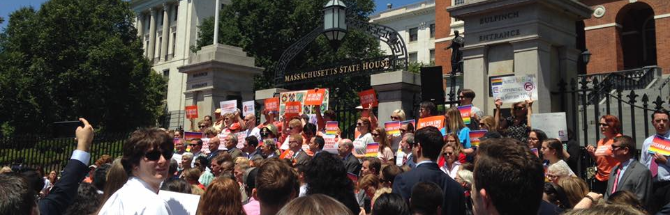
Counting Down to State House Advocacy Day!
Notes:
If you haven’t RSVPd yet please do: https://docs.google.com/forms/d/e/1FAIpQLSf2lgrCOBnM2acCzObw0ZtRDHtyr3yRU2r_N8PklnAYICsBdw/viewform
Please share the link with your colleagues. We already have about 170 people registered and planning to join.

Slide 5
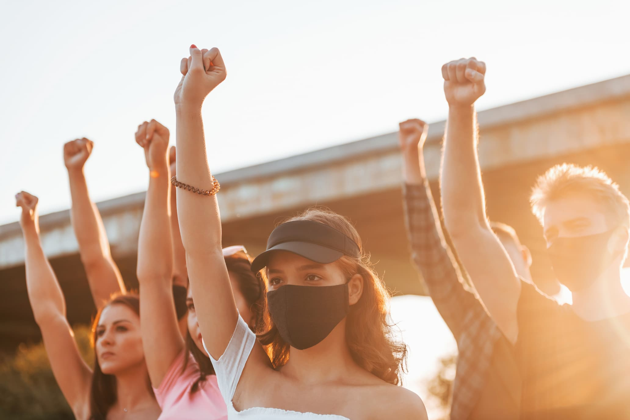
Why come to CLM's State House Advocacy Day?
Having a big group, in person helps make us more influential
You’re an expert on these issues and personal stories have the most impact
Legislators are elected to represent you and have so much to learn from you
Networking with fellow child welfare peers and organizations helps us build connections and gain knowledge in our field
Notes:
I bet all or almost all of you are coming next week, so you already know it's a valuable to participate in advocacy day.
It's energizing to review why it's so important for us to host and attend our State House Advocacy Event
We know advocacy with our legislators is a powerful way to make changes for our providers and the populations of children and families you serve.
A "strength in numbers" approach is necessary to move bills through the legislative process and support healthy budget priorities.
Legislative offices often track the number of people who reach out to them on certain issues to gauge its importance and urgency
As a reminder to all of us who feel shy when we get to our legislators' offices:
- Decision makers represent our communities on such a wide variety of issues and you are the experts on children and family services.
Most of your organizations can help rally the populations affected by the legislation and budget items we're advocating for – including staff and youth – we have seen a bunch of organizations planning to bring a bunch of folks with them. Thank you! That's powerful! Who is brining people with them next week and have you indicated that on the registration?
We also enjoy the chance to see you and talk to you in person at an event like this. It's great for networking and relationship building and to celebrate the amazing work you all do

Slide 6
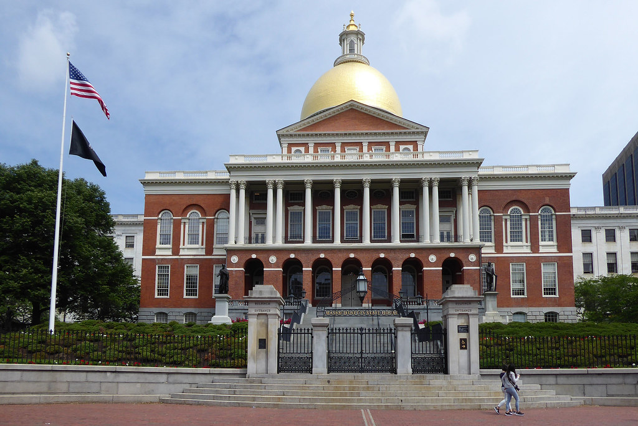
Logistics
Address: Massachusetts State House 24 Beacon St, Boston, MA 02133
Entrances: Beacon Street or Bowdoin Street (accessible)
Program Location: Great Hall/Hall of Flags (2nd floor)
Time: Registration starts at 10am & the program starts at 10:15am; Suggested State House arrival time: 9:30 or 9:45am
Suggested Dress Code: Business casual
Notes:
To arrive on May 16th - (throw this link in chat: https://www.childrensleague.org/wp-content/uploads/2024/05/Directions-to-State-House.pdf
public transportation is Recommended
There are two Entrances (one closer to the Common and the other towards the middle of the bldg)
We’ll be in the Great Hall of Flags
after going through security, take an elevator to the 2nd floor; you’ll head toward the center of the building to find the beautiful room; registration will be just inside the main door
Bathrooms are located on all floors except the 3rd
We're providing beverages and granola bars; There are also vending machines and sometimes the café is open on the 4th floor
We recommend business or business casual attire and I highly recommend wearing comfortable shoes because there is typically a decent amount of walking to get to the event space room and then to your legislators offices

Slide 7

Did anyone attend CLM's State House Advocacy Event last year? What did you like about it? Do you have any insider tips – things you're glad you know now – that any first timers might want to know?
DISCUSSION:
Notes:
Did anyone attend CLM's State House Advocacy Event last year? What did you like about it?

Slide 8
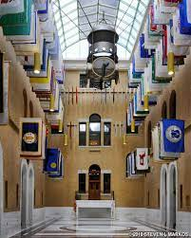
Program Agenda - Great Hall of Flags
Tips for Arrival
Public Transportation
Give yourself time to park and/or walk - suggest State House arrival at 9:30 or 9:45am
10 a.m.
10:15 a.m.
11:35 a.m.
Registration and Networking at the Great Hall
Performance & Program with Awards
Legislative Office Visits
Notes:
Regarding the Program for our State House Advocacy Day – here's a quick overview slide and I'll dive in on the next slides
You're welcome to join us at 945am for registration and networking
Our speaking program with legislative champions and awards to staff members will begin at 10:15am
Then we'll have our legislative office visits around 1130am

Slide 9
1) Registration and Networking
Registration Table and Tote Bag Pickup
Social Media Activities: (1) Pin Map and (2) Social Media Station
Light Refreshments
Networking
Notes:
You're welcome to join us at 945am for registration and networking
When you sign in at registration, you can grab a name tag, a pin, you'll get a CLM logo tote bag with resources, and visit the CLM map to pin your program location and social media station (with a few blank signs to take photos with) [Tasmiah will give you more details on later in this presentation].
There will be a light refreshments (coffee/tea/water and granola bars)
And the chance to network as folks gather

Slide 10
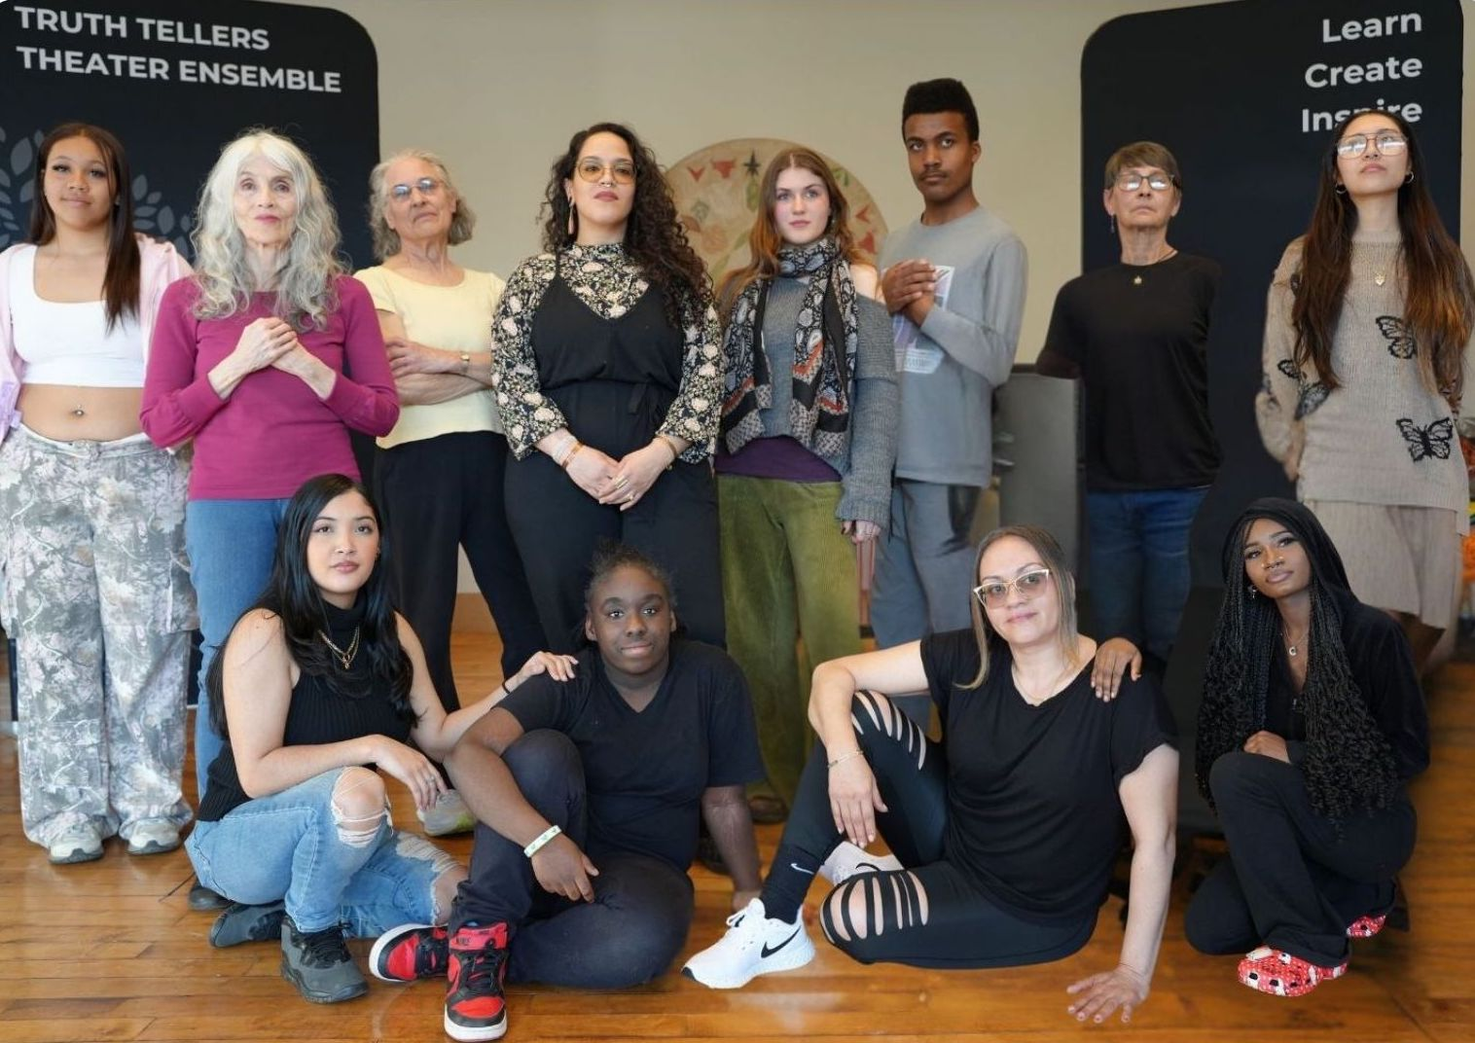
2a) Catalyst Performance
Intergenerational Truth Tellers Theater Ensemble, honoring lived experiences with the child welfare system, brought to you by Treehouse Foundation's HEROES Youth Leadership Program and Arts Integration Studio.
Notes:
Our speaking program – which will run from about 10:15 to 1130am with Rachel as our MC.
We'll hear from our legislative champions: Rep. Kay Kahn, Sen. Robyn Kennedy, and Rep. Tricia Farley-Bouvier.
The presentation of awards to staff members will highlight their amazing work of course.
And then Rachel will wrap up our call for support on children and family priority issues.
___

Slide 11
2b) Speaking Program
Welcome
Rachel Gwaltney, CLM’s Executive Director
Legislative Awards
Child Welfare Champions
Rep. Livingstone
Sen. Comerford
All-Time Champion for Children
OCA Director Maria Mossaides
Member Awards
Direct Care Staff
Program Managers
Closing
Rachel Gwaltney, CLM’s ED
Notes:
Our speaking program – which will run from about 10:15 to 1130am with Rachel as our MC.
We'll hear from our legislative champions: Rep. Kay Kahn, Sen. Robyn Kennedy, and Rep. Tricia Farley-Bouvier.
The presentation of awards to staff members will highlight their amazing work of course.
And then Rachel will wrap up our call for support on children and family priority issues.
___

Slide 12
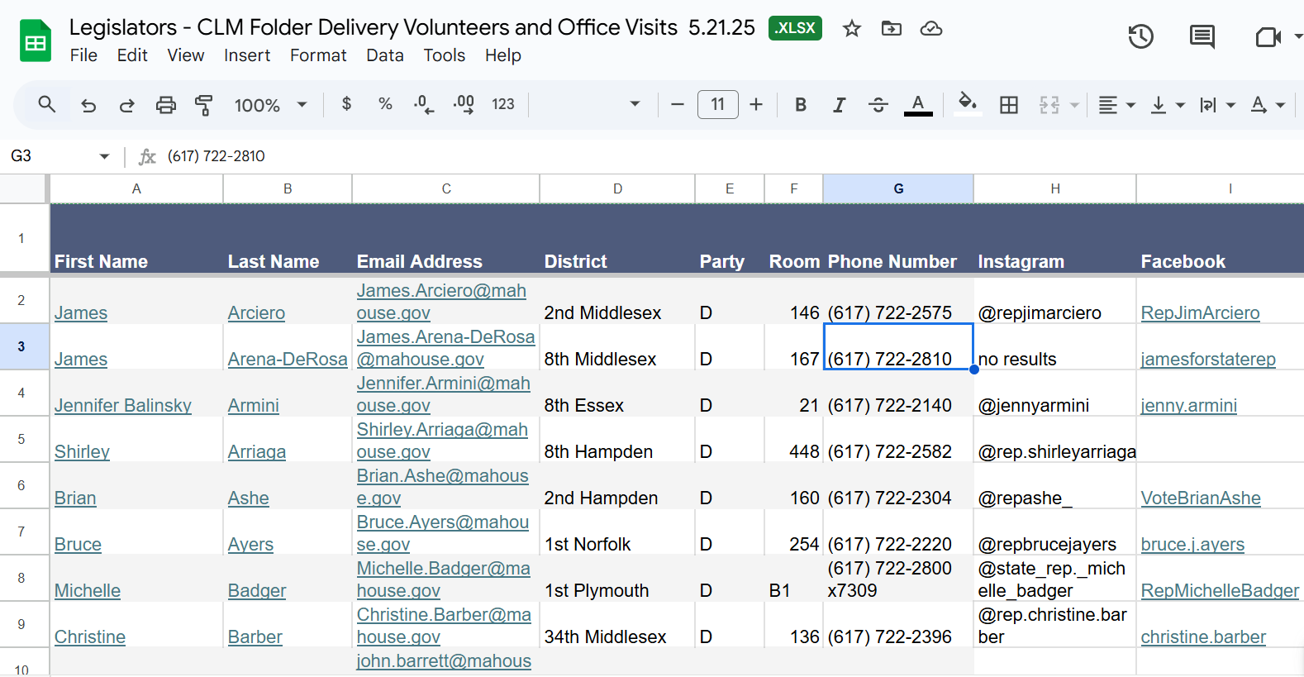
3) Legislative Office Visits
Members - visit your legislators & help deliver resource folders.
Please sign up! This spreadsheet can help with coordination:
Notes:
After our speaking program,
We urge all Members to head to their legislators' offices.
Some have reached out to schedule meetings in advance which is great. Those of you who haven't can still drop in. This spreadsheet: https://docs.google.com/spreadsheets/d/1WhoPNH6FDIQF7qKCbAotY0dMAlk-7HvfQC5JsuNBIAk/edit#gid=0 lists the meetings planned.
It's great to coordinate with other groups who want to visit the same legislators. We encourage you to pair up or group up if you see legislator visit plans in common.
Thanks to those who already signed up as Volunteers when they RSVPd – more are welcome – you can just email me - you'll be the group we rely on to deliver a resource folder to each legislators office. After the speaking program, you'll see me and a sign that says Volunteers. We'll meet there to divide you up by floors – you'll be able to go with other volunteers to deliver the folders. We want every office to have one of our folders before we leave. Many of the offices have several legislators to one room number – so the delivery can be quick.

Slide 13

Legislator Folders – Members to Help Deliver
CLM "About Us" with Key Facts
General QR Code Links to CLM Website Resources, including Fact Sheets
CLM Legislative Agenda
CLM Budget Priorities
Fact Sheets on the following bills:
Child Welfare
Bill of Rights for Children in Foster Care
Protecting Benefits Owed
Optional: information sheet about your organization
Notes:
The resources for legislators will include what's listed here (I'll show them the folder and docs)

Slide 14

Resources in Tote Bag for You
CLM's About Us with Key Facts on the back
CLM's Legislative Agenda
CLM's Budget Priorities
State House Advocacy Day Event Agenda with Talking Points on the back
Advocacy Day QR Code links to:
List of Legislators
Link to "Find My Legislator"
Map of State House
CLM's Bill Fact Sheets
Link to CLM's Legislative Agenda on the website
Link to CLM Budget Table on the website
Notes:
Your tote bag will include
CLM's Legislative Agenda and Budget Priorities like the Legislators folders have AND there will be an
event agenda which has social media prompts at the bottom (Tasmiah will speak to those shortly) and there's a QR code that links to the list of legislators (that has districts, office location, social media handles, and if they were a lead sponsor on one of our legislative agenda bills). The QR code also links to the fact sheets that are included in the Legislator's folders.
on the back of the event agenda, there are data points on WHY we advocate

Slide 15
Priority Legislation
Resolve for a Foster Care Liability Insurance Special Commission S.1280 / H.197 (Sen. Velis; Rep. Arena-DeRosa) Establishes special commission to study MA DCF-contracted providers of comprehensive foster care challenges in sustaining foster care liability insurance.
An Act Enhancing Child Welfare Protections S.148 / H.262 (Sen. Kennedy; Rep. Livingstone) Comprehensive child welfare bill enhances reporting/analysis on disproportionality, reporting on transition age youth outcomes, and more timely notifications to children and youth attorneys.
Bill of Rights for Children in Foster Care S.107 / H.235 (Sen. Comerford; Rep. Finn) Codifies and creates rights for children in care, such as promoting connection to family, community, and identity, prioritizing families first with placements, and promoting siblings’ connections.
Protecting Benefits Owed to Foster Children S.105 / H.227 (Sen. Comerford; Rep. Farley-Bouvier) Ensures kids eligible for benefits get them and receive financial literacy training.
An Act Expanding Access to Higher Education Tuition and Fee Waivers for Adopted Foster Children S.918 / H.1431 (Sen. Comerford; Rep. Garballey) Codifies that full tuition/waivers will be granted to emerging adults in DCF or legal guardianship; also supports children who are adopted from DCF.
An Act Relative to Adoptions S.1046 / H.1975 (Sen. Creem; Rep. Sabadosa) Codifies that an adoption outside MA shall be valid per MA law or laws where it was executed. Corrects a recent judicial interpretation prohibiting a MA form use by out-of-state birth parents unless signed in MA.

Slide 16
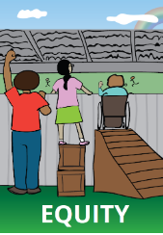
Bill Talking Points
PROBLEM Children of color are significantly overrepresented within Massachusetts’ child welfare sector.
And, LGBTQIA+ youth and children with disabilities have been insufficiently tracked.
SOLUTION An Act to Eliminate Disproportionality and Inequities for At-Risk Children will improve outcomes by ensuring two necessary and missing factors come into play here in the Commonwealth:
Better Data Across State Agencies
Accountability with Oversight and Corrective Action Plans
Notes:
As we are encouraging, Many of you will probably speak to the Disproportionality Bill – even if you don’t its Fact Sheet will be in the folder for each office.
As an example of talking points for a bill – I recommend highlighting the problem and solution – and tie in something about your personal work and experiences,

Slide 17
Priority Budget Line Items
Congregate Care (4800-0041) $495.9M and add funding to implement a pilot program, as approved in the FY24 Budget, to address the high concentration of "high acuity" adolescents residing in congregate care, which negatively impacts the safety, climate, and effectiveness of these care settings. Having successfully diverted many youth from the juvenile justice system, we need a wider array of non-DYS services to meet their needs.
Family Support and Stabilization (4800-0040) $139.5M to support delivery of high-quality, evidence-based preventative services, including significant new, evidence-based services expected in an RFR to be implemented in FY25. These programs pay dividends for the state by effectively reducing child abuse and neglect cases, allowing children to stay safely in their homes, and reducing trauma for children and families.
Family Resource Centers (4800-0200) $27.3M and an additional $5M of flexible funding to address significant strains on staff and resources and continue delivering the myriad of critical, locally relevant, and ever-evolving programming for families, particularly as the migrant crisis continues pushing FRCs to their limits.
Temporary Assistance for Families with Dependent Children (4403-2000) and Emergency Aid to the Elderly, Disabled and Children (4408-1000) 20% increase because the current maximum cash assistance grants are far below even half the federal poverty level (Deep Poverty) which hurts kids through health and emotional damage, housing instability, toxic stress, and impaired school performance (the Governor’s budget would freeze grants at inadequate 2022 levels).

Slide 18
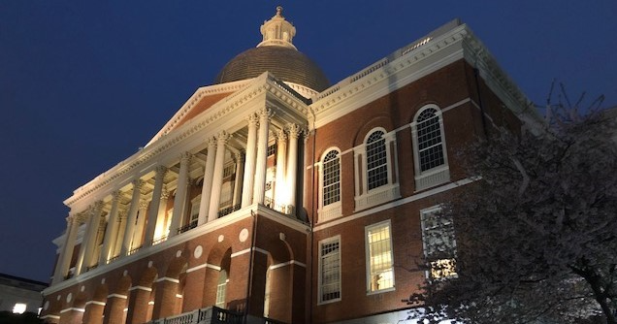
State of the State House on 5/21/25
Legislative
Hearings have begun; Can still ask for co-sponsors
Budget
Senate
Notes:
As for what legislators will be up at that time
Final votes on legislation will begin happening; a few committees still have some reporting out to do (this list on our website indicates what bills are with what committees and what the deadlines are:
https://www.childrensleague.org/wp-content/uploads/2024/05/CLM-2023-2024-Legislative-Agenda-May-7-2024-for-website.pdf
and the Senate Ways and Means just put out their budget; amendments are due today; Senate debates will begin the week of the 20th following our event.

Slide 19
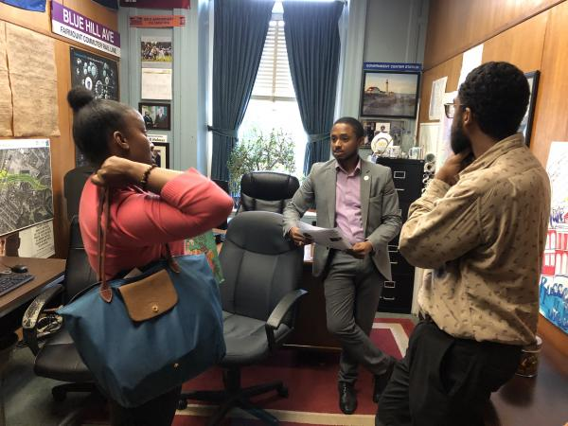
Meet with Your Legislators
Introduce yourself
Ask to briefly speak with a legislator about a few priority bills and budget items
Stick to key points
Use your personal experiences to talk about your critical work
Share resources
Volunteers - you'll go with other volunteers to drop a resource folder to each office
Members - feel free to refer to docs in the tote bag you'll receive at check-in; let the staff know a fellow member volunteer will drop off a resource folder from CLM
Give thanks for their time/commitment to children and families
Notes:
The QR code on the event agenda links to resources including the Legislators List with office numbers.
When you get to an office -
Introduce yourself as a constituent and a member of The Children’s League of Massachusetts at the Office for our Advocacy Day. Ask if you can briefly speak to the legislator about a few critical child welfare priorities. If the legislator is unavailable, treat the staffer just like the legislator because they are the eyes and ears of the legislator.
If you're one of our volunteers - give them the resources folder you have for them. If you're not, let them know a fellow CLM member volunteer will be dropping off a resource folder if they haven't already.
Refer to CLM’s Legislative Agenda and Budget Priorities Sheet and point out the bills/line items that you feel are most important and explain why. I recommend mentioning just a few highlights. Please ask them to support our agenda and those bills and line items. You can also refer to key data on the back of the event agenda.
As noted before Use specific examples about your work and those you serve, there's so much for legislators and their staff to learn from you. And you'll help them see why our bills/funding will make a real difference in the lives of children and families.
Lastly, Thank the legislator and staff for their time and commitment to children and families in their district
If they ask a question that you are unsure of, you can let them know that you or someone from CLM will get back to them, and we’ll be happy to help.
We also encourage you to take a photo with your legislator and group & post on social media
If no one is in the office, leave the resources in the legislator’s mailbox (if there’s access) or in (or under) the door. Please make sure to add a personal note! This will add great value to the resources and likelihood they won’t be lost in the shuffle. - could be as short as Hi Senator [and fill in their name], I'm a member of The Children's League. Please support our priorities. Thanks for your time, [and include Your Name]. You might want to add something about your program, especially if it's in their district and your contact info.
Remember to Be patient – legislators may be unavailable or interrupted; staffers are fantastic points of contact who will relay information and your ask

Slide 20
Flow/Talking Points
Introduce yourself - constituent and Children’s League member
Ask to briefly speak with the legislator or staff about a few important priorities for children and families.
Thank offices that are sponsors/co-sponsors of our bills.
Ask for support to pass key bills and budget line items. Point to priorities in the resource folder that you leaving behind for them.
Use your experiences to explain why these issues are important.
Thank them for their time and support; take photos
Hard question - let them know that you or someone from CLM will get back to them. (Take notes if it helps you & let us know).

Slide 21

Post-Legislative Visit Steps
Let us know if you have any trouble dropping a folder or if you received confirmations of support or questions (we're happy to help with answers and/or follow up)
Email Sue@childrensleague.org
Post on social media
Send pics and/or post CLM (you can also email Gavin@childrensleague.org)
Send thank you notes/emails
Notes:
Gavin, our Communications & Public Policy Specialist will now share more tips focused on our Social Media strategy for May 21st.

Slide 22
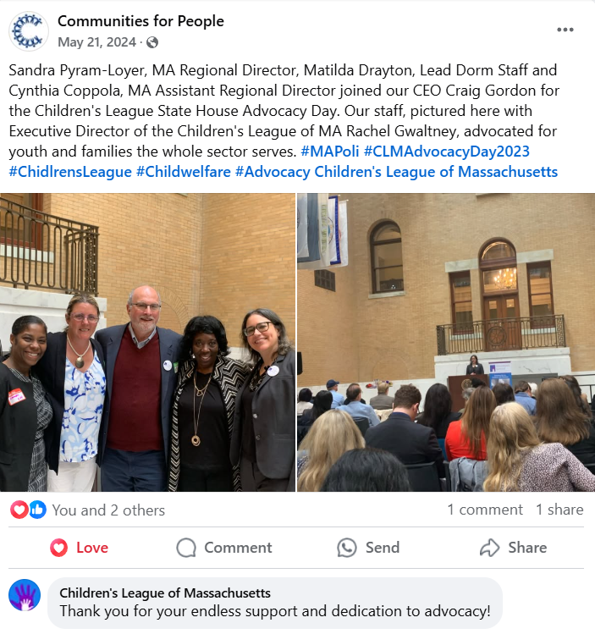
Share Photos from Advocacy Day on Social Media!
Share across Facebook, X (Twitter), LinkedIn, Instagram, Threads
Tag CLM, other Members, and your legislators
Include photos
Event Hashtags:
#CLMAdvocacyDay2025
#StandUpForChildren
#MApoli
Notes:
CLM is active on the above social media platforms. Tagging is one of the best ways to boost interaction on social media – be sure to tag us and partner member organizations. Include any of your organizational hashtags that you typically use on your social media sites. Here we see Craig and Communities for People and their facebook post from last year's advocacy day – good use of hashtags!

Slide 23
Sample Social Media Post Language
"Today, we joined fellow Members of the Children’s League of Massachusetts for State House Advocacy Day on Beacon Hill!
We celebrated legislative champions @senrobynkennedy and @jaylivingstone along with program leaders and direct service staff who have dedicated their careers to improving outcomes for children and families in the Commonwealth.
#CLMAdvocacyDay2025 #MaPoli #StandUpForChildren”
Notes:
This is an example with tags and hashtags that could be used on most social media platforms. This will be included in our social media toolkit which will be sent the day before advocacy day and we will have this prompt posted on paper at our social media station – pictured in the next slide.

Slide 24
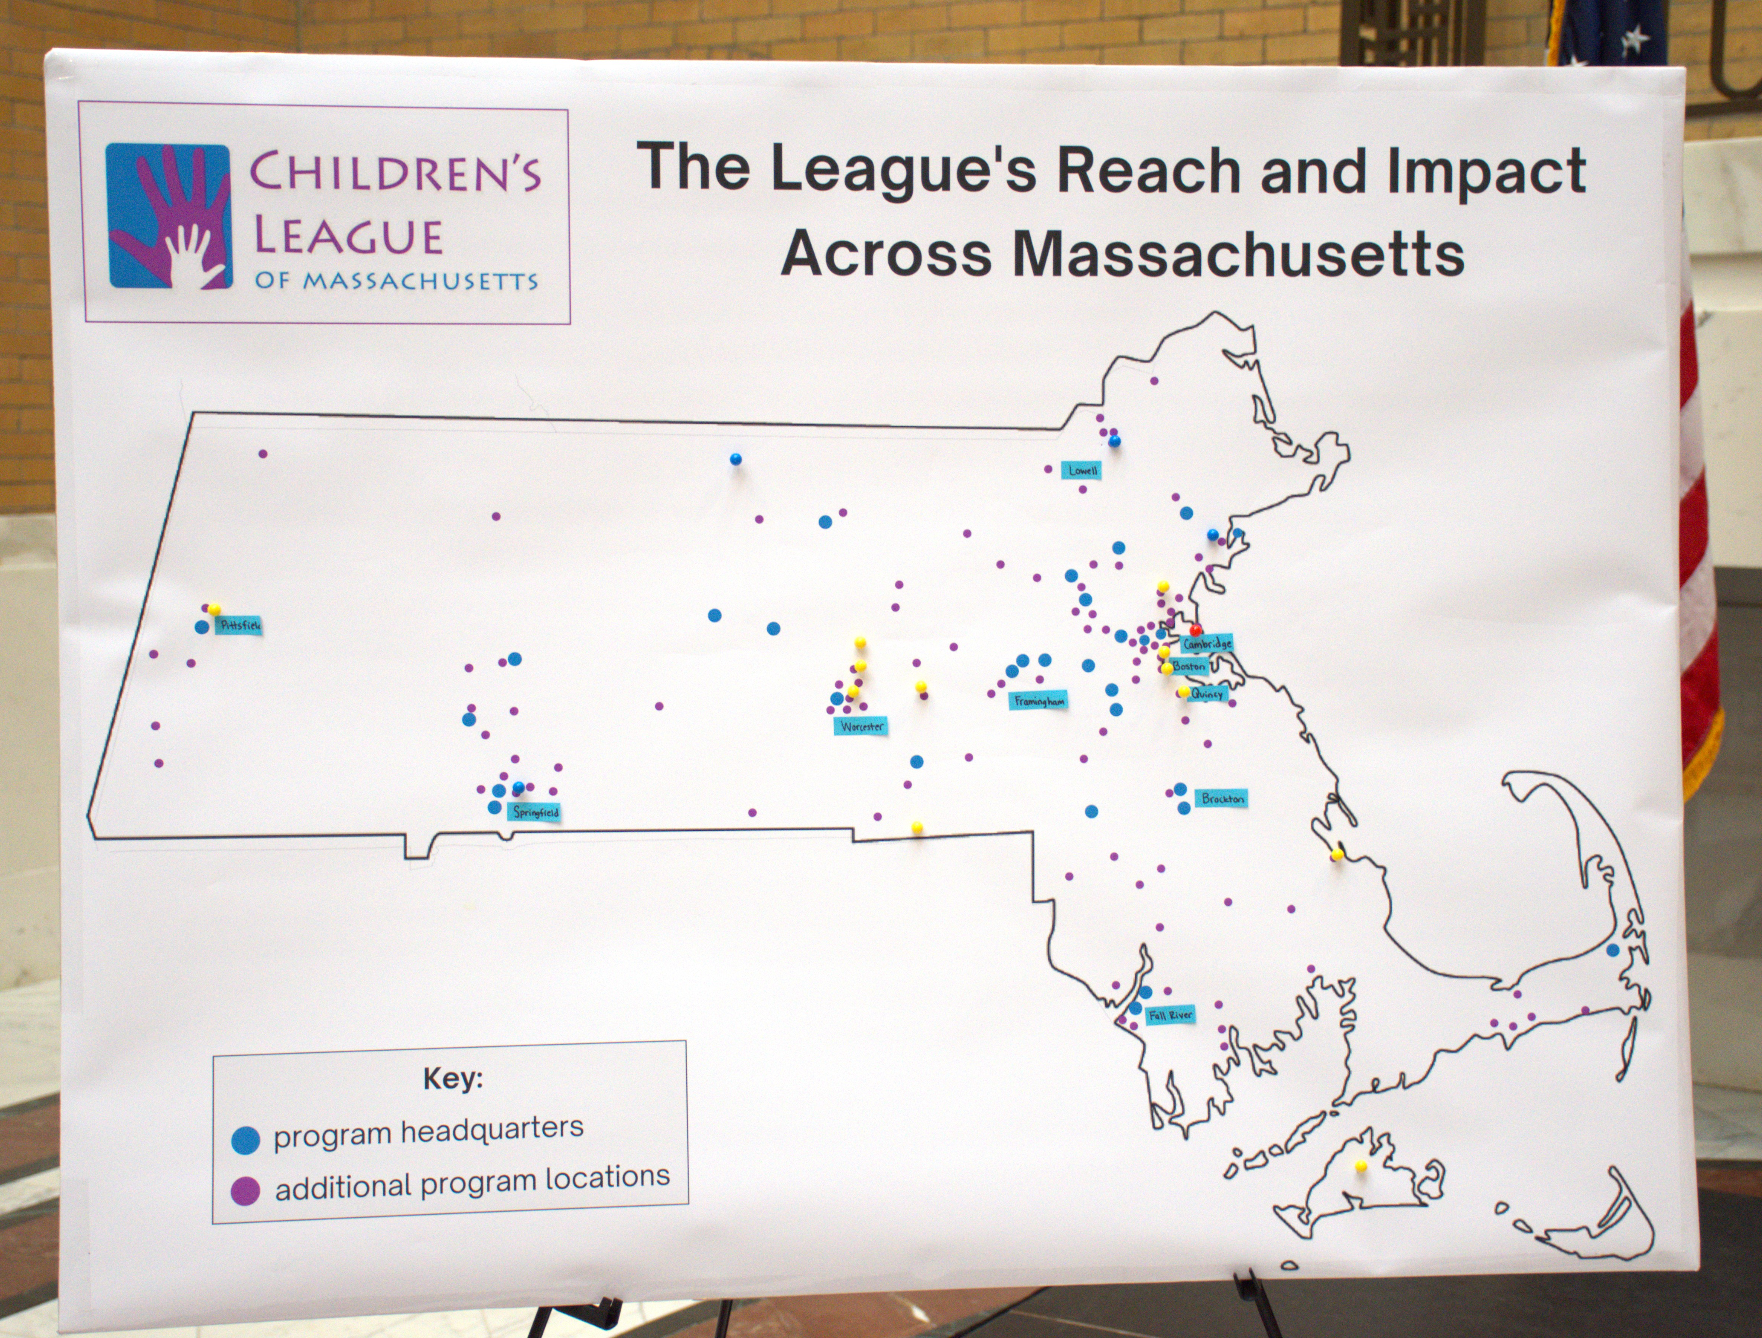
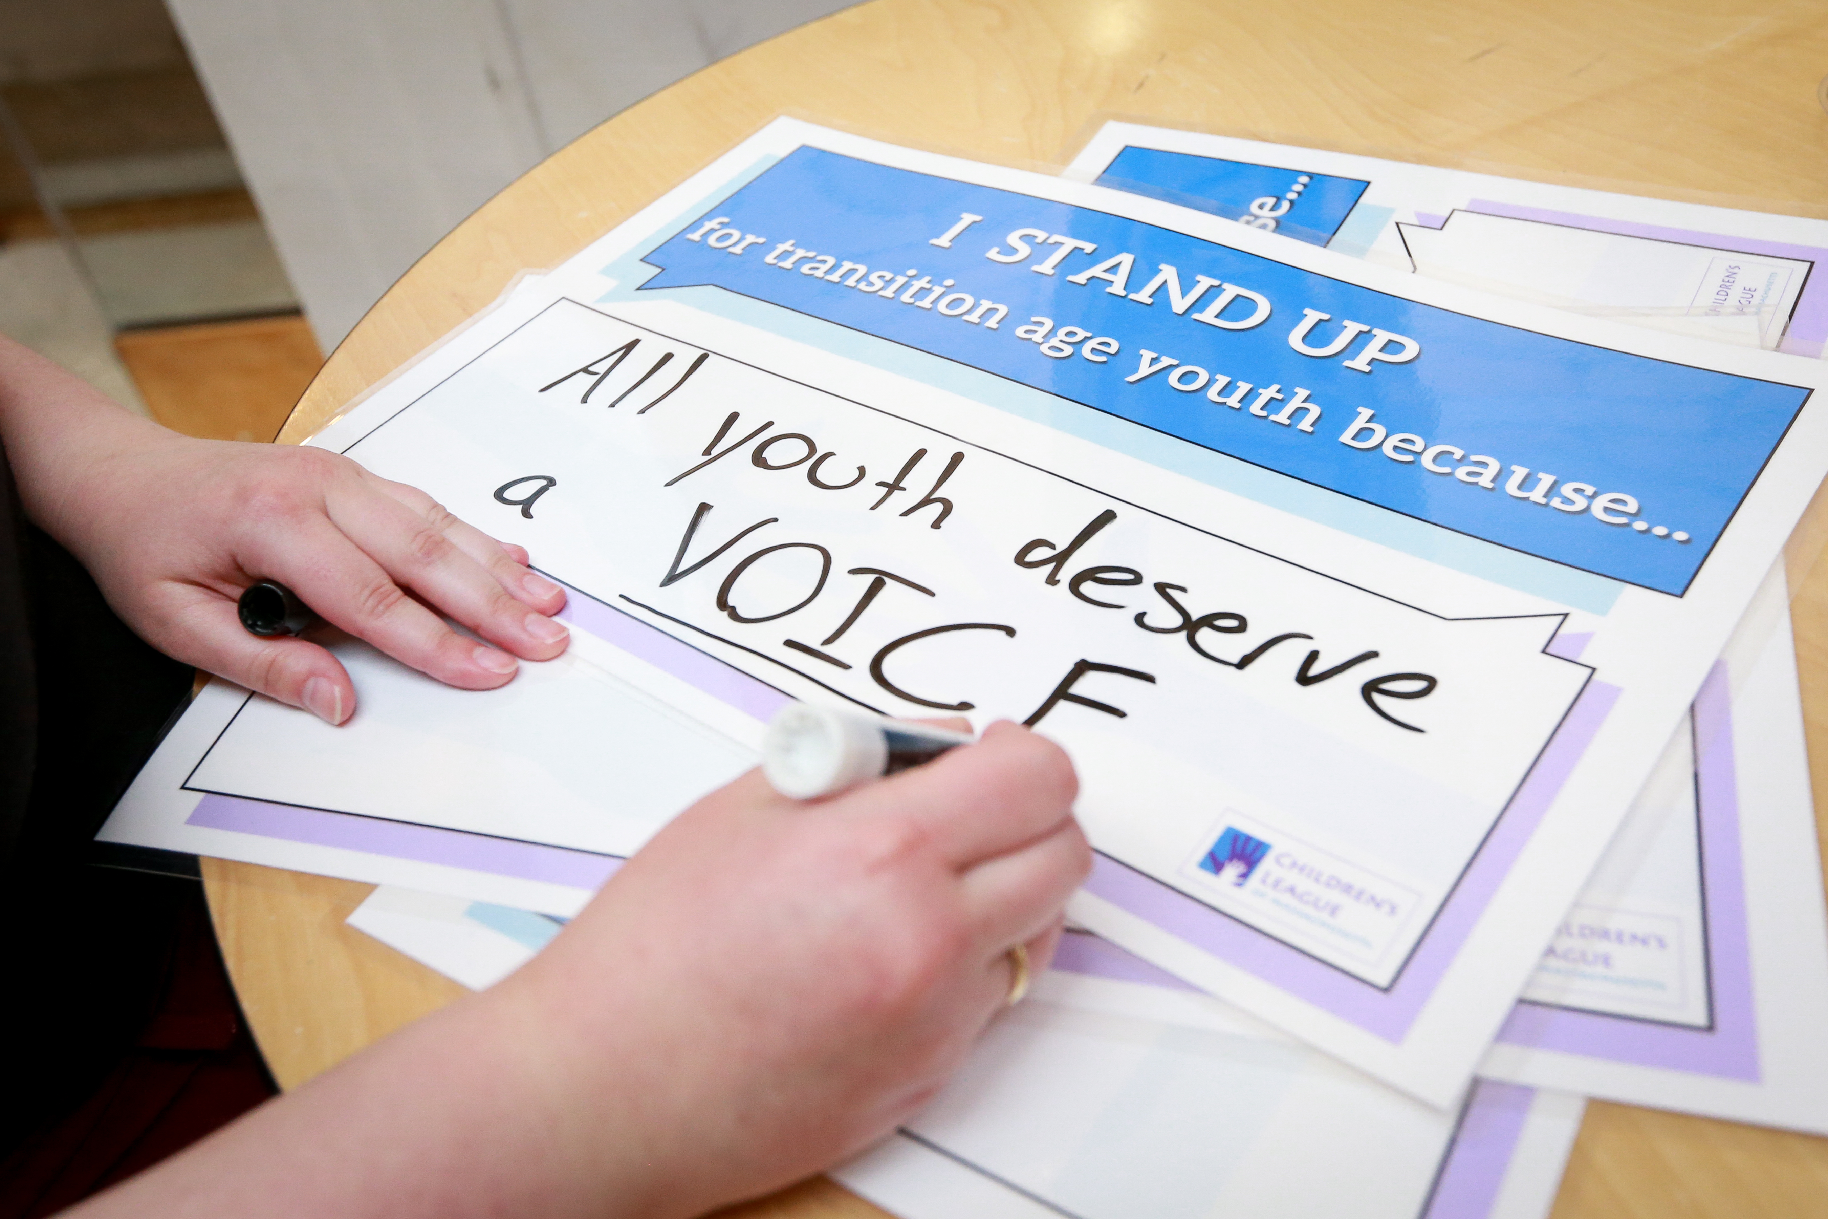
Social Media Activity
'Pin the Map' activity – Showcase our League's reach across the state
Social Media Station – Take pictures with "I Stand Up for children, family, and youth because..." signs
Notes:
Please participate in these social media post opportunities before and after the program. You can place a pin on our state of Massachusetts poster to show the reach of our League's members – creates a great visual! Also please use the provided EXPO markers on our "I STAND UP" signs and pose with those in the Great Hall. We will have a photographer roaming around that you are more than welcome to ask for pictures of you and your organization.

Slide 25
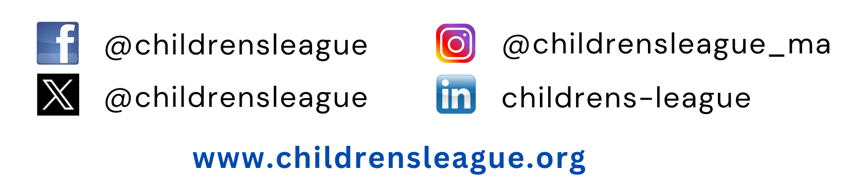
Follow CLM on Social Media!
Notes:
Handing this back over to Sue now...

Slide 26

What would you like to add?
Notes:
Would anyone like to share any more comments or questions?

Slide 27

Reach out anytime
Sue O’Callaghan, Esq.
Director of Public Policy
sue@childrensleague.org
Office: (617) 695-1991
Cell: (518) 469-6504
Gavin Clark
Communications & Public Policy Specialist
gavin@childrensleague.org
Office: (617) 695-1991
Notes:
Feel free to contact me or other members of our team anytime. My contact info. is here and our team’s is on our website https://www.childrensleague.org/about-us/
At the end of this PowerPoint is a recap of our previous trainings for anyone wants to look back at an overview on our State Legislature and timelines for passing legislation and the budget. Thank you all so much for joining this morning and I hope you have a nice weekend.

Slide 28

GENERAL Advocacy Guide RECAP
Notes:
Diving into a general Advocacy Guide

Slide 29
CLM Calls For Action
Outreach: meet with, call, or email your legislators
Create and sign on to letters to legislators and the Governor
Create, present, and sign on to testimony for hearings
Spread the message (fact sheets, social media, blog posts, surveys)
STAY CONNECTED:
Join a CLM Task Force and/or Coalition
Read/share CLM Newsletters, Action Alerts, Social Media Campaigns
Check CLM’s website and Member’s Portal
Notes:
By now most of you have probably reached out to your legislators to become co-sponsors of our priority bills. The growing list is in the description of both the disproportionality bill and the foster care liability insurance bill on our website.
As May approaches, we’ll reach out with more calls to action – please participate and share
coming right to your inbox - Please Look out for our Newsletters and on your social media – please follow us on facebook and Twitter to see our posts –
Again, We’ll highlight when you should contact legislators, sign petitions, and/or do other things like participate in a survey that can help with data collection
If you aren’t already on a Task Force or Coalition – check out an overview of them on our website [PUT IN CHAT: https://www.childrensleague.org/advocacy/clm-task-forces-and-coalitions/]; in our members portal there’s more info. like past meeting notes. We discuss policy items and target priority issues together during our Task Force meetings.
Our website is full of information on policy issues and advocacy opportunities – with frequent updates; and we update our member’s portal often too
Tasmiah is dropping it into the chart now – here's a link to our member's only listserve https://lp.constantcontactpages.com/su/TIxxL3l/membersonly

Slide 30
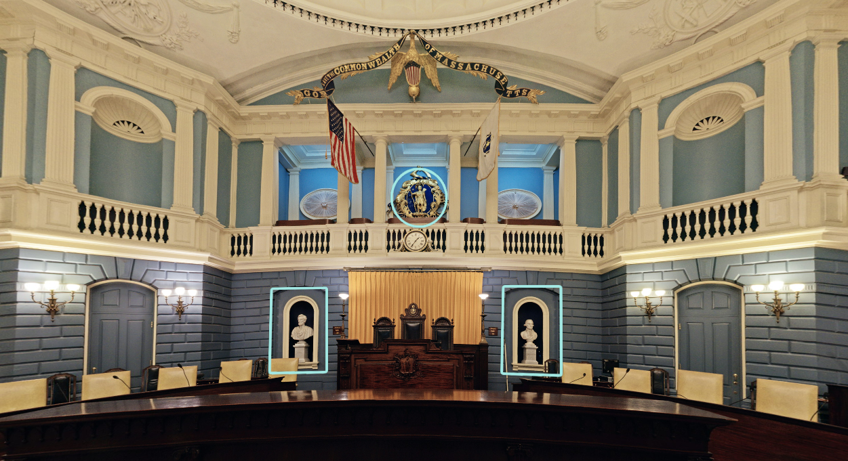
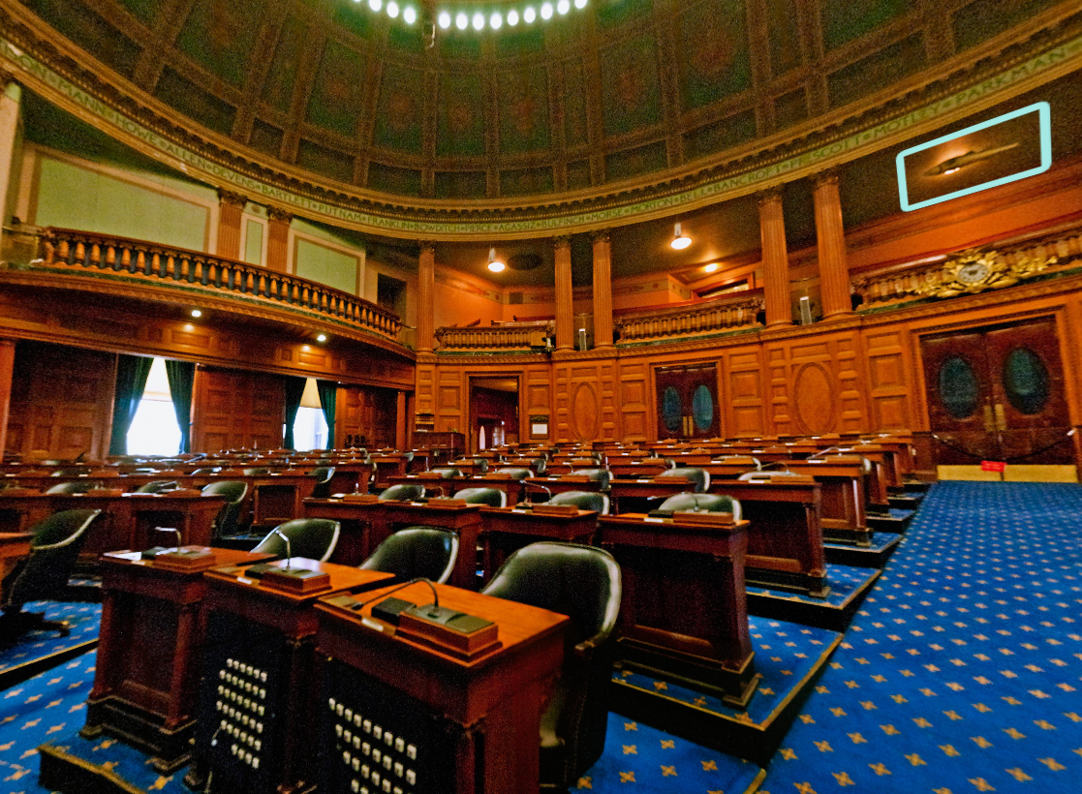
The Massachusetts Legislature
Two-year legislative cycle
Legislators serve two-year terms without limits
Current Session: 194th General Court
Most activity: Feb. – June each year
SENATE
HOUSE
Senate: 40 members (Represent ~159,000 people)
House: 160 members (Represent ~40,000 people)
Notes:
Here’s our refresher on Mass Legislature basics

Slide 31
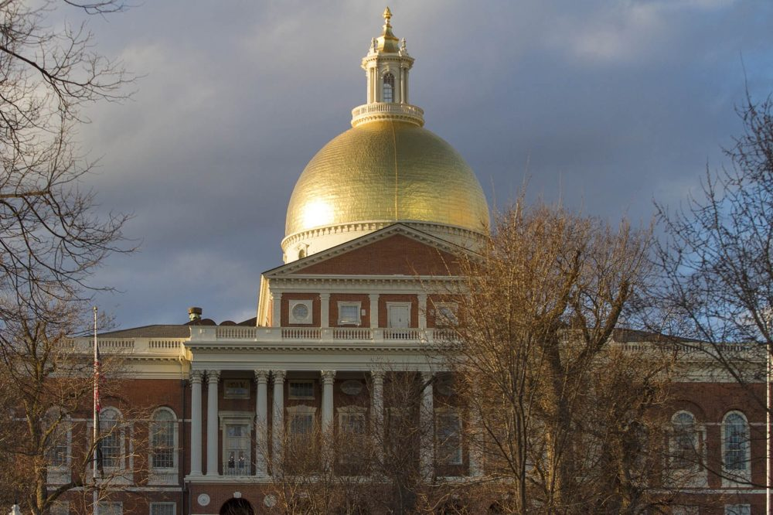
Bill Movement Overview
2) Post-hearing Decision & Floor Debate (2nd Reading)
4) 2nd Branch (3 Readings) -> back to Original Chamber
1) Filed -> Committee (1st Reading) & Public Hearings
5) Conference Committee
6) Governor
3) Standing Committee on Bills in Third Reading & Vote (3rd Reading)
Notes:
Understanding the Movement of Bills through the State House can help us understand who to contact and when – Here’s an overview of the steps we’re going to walk through with a little more detail to follow
Bills are filed in both the House and Senate, so different bills journeys begin in one chamber or the other. A lot of our bills have a house version and senate version that’s the same right
But they may take different paths. Conference Committees would ultimately help with bringing each side together on a bill.
You’ll notice one of the ways to describe milestones in the “life of the bill” is by its 1st, 2nd, and 3rd Reading –
The 1st reading is an introduction
The 2nd reading is before it's debated on the Floor for the first time - a Floor Debate (is a formal discussion in which our legislators have the opportunity to express different opinions about a bill and then vote on it)
Then at the 3rd reading, the bill is ready to be favorably voted on (they call it "ready to be engrossed")
YOU'LL ALSO NOTICE THERE IS AN OPPORTUNITY TO ADVOCATE EVERY STEP OF THE WAY.

Slide 32
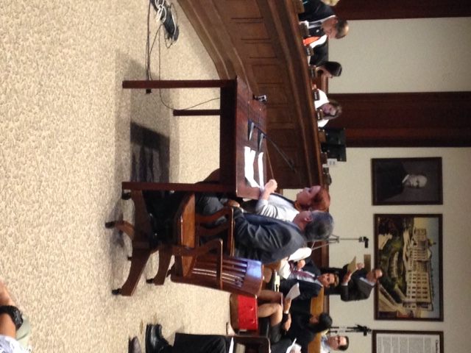
Legislative Session Advocacy
Committee-Time Outreach
Co-Sponsors Outreach (once bill filed until leaves committee)
Lobby committee members to make favorable committee report
Testify at public hearings
Prepare other members for the coming floor debate
Bills in the Third Reading
Lobby committee members
Prepare other members for the final floor debate
Governor’s Office
Advocate for her final signing of a bill
Notes:
Here’s a summary of when to advocate – WHICH IS REALLY EVERY STEP OF THE WAY. YOU can make a difference! & Together we have more impact.

Slide 33
Budget Advocacy
Inform each segment (Agencies, House, Senate, and Governor's Office) leading up to and during their time of input on the budget
Decision Maker | Timeframe
State Agencies/Exec. Offices | Sept. - Dec.
Governor | Jan. (incumbent); Feb. (new)
House | March - April
Senate | May - June
Conference Committee | May/June
Governor | June/July
Notes:
Here’s a summary of when to advocate – WHICH IS REALLY EVERY STEP OF THE WAY. YOU can make a difference! & Together we have more impact.

